Slide 1

CIT-2180 Data and Database Management Chapter 9 (PART TWO)

Slide 2

Oracle 12C: SQL
Chapter 9 (PART TWO)
Joining Data from Multiple Tables

Slide 3
Non-Equality Joins
In WHERE clause, use any comparison operator other than the equal sign (traditional)
In FROM clause, use JOIN…ON keywords with a non-equivalent condition (ANSI)
Example: An annual promotion at JustLee offers a free gift based on the value of each book purchased. A non-equality join is used to determine which gift a customer receives.
3

Slide 4
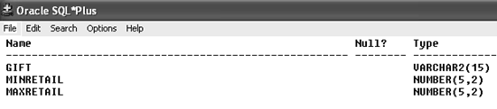

Non-Equality Joins: WHERE Clause Example
4

Slide 5

Non-Equality Joins: JOIN…ON Example
5

Slide 6
Self-Joins
Used to link a table to itself
Requires the use of table aliases
Requires the use of a column qualifier
Example: A customer who refers a new customer to JustLee books receives a discount certificate for a future purchase (see Referred column in the customer table). So we need to join the Referred column with the Customer# column.
6

Slide 7
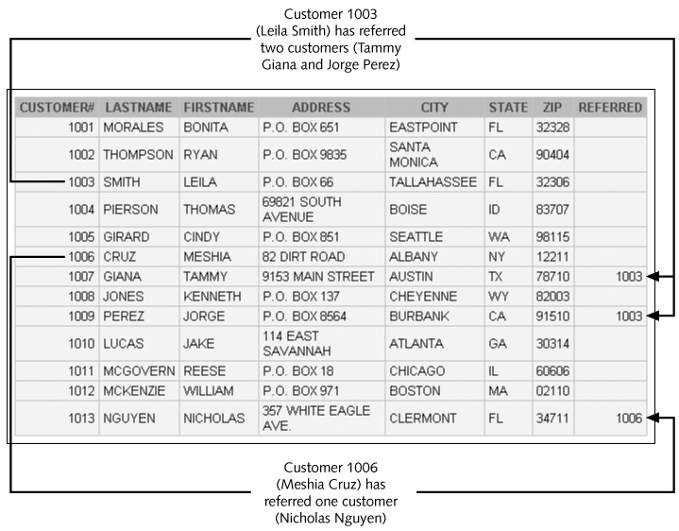
Customer Table Example
7

Slide 8
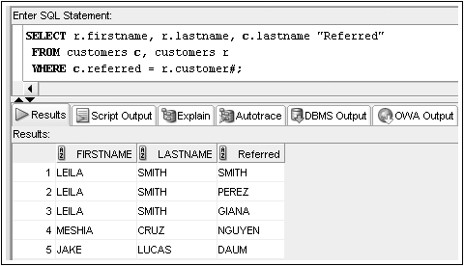
Self-Joins: WHERE Clause Example
8

Slide 9
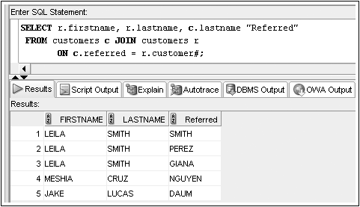
Self-Joins: JOIN…ON Example
9

Slide 10
Outer Joins
Use outer joins to include rows in one table that do not have a match in the other table
In WHERE clause, include outer join operator (+) immediately after the column name of the table with missing rows to add NULL rows (traditional)
In FROM clause, use FULL, LEFT, or RIGHT with OUTER JOIN keywords (ANSI)
Example: Suppose we want a list of all customers, (not just ones who’ve placed an order) and order #’s for orders the customers have recently placed.
10

Slide 11
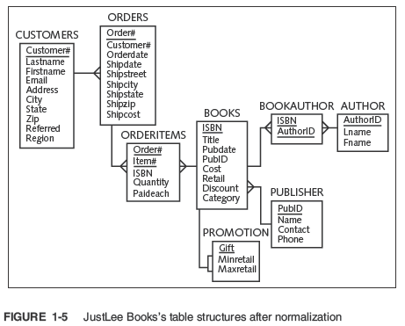
Customers and their orders, even if no current orders.

Slide 12
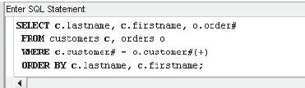
Outer Joins: WHERE Clause Example (traditional)
(+) is placed in the WHERE clause immediately after the column name from the table that’s missing the matching row (the deficient table). SQL will create a NULL row in that table to complete the join.
12

Slide 13
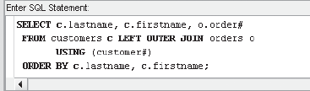
Outer Joins: OUTER JOIN Keyword Example (ANSI)
LEFT [OUTER] JOIN – Non-deficient table is on the left, keep all rows from the LEFT table, even if right rows are absent
RIGHT [OUTER] JOIN – Non-deficient table is on the right, keep all rows on the RIGHT table, even if left rows are absent
FULL [OUTER] JOIN – Keeps all rows from both tables
13

Slide 14
Outer Joins (continued)
If multiple join conditions are used, the outer join condition may be required in all of the join conditions to retain nonmatching rows
SELECT o.order#, b.title
FROM customers c, orders o, orderitems i, books b
WHERE c.customer# (+) = o.customer#
AND o.order# (+) = i.order#
AND i.isbn (+) = b.isbn;
Example: Suppose we want a list of all books, (not just ones on an order) and customers who ordered those books.
14

Slide 15
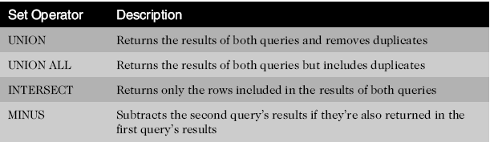
Set Operators
Used to combine the results of two or more SELECT statements
15

Slide 16
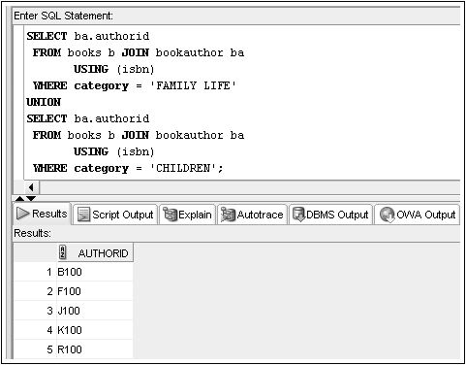
Set Operators: UNION Example
16

Slide 17
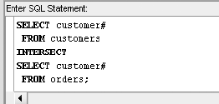
Set Operators: INTERSECT Example
17

Slide 18
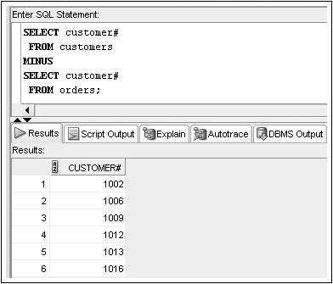
Set Operators: MINUS Example
18

Slide 19
Oracle 12C: SQL
END OF Chapter 9
Joining Data from Multiple Tables

